Slide 1
Network Sentinel
Integrating Machine Learning and Retrieval-Augmented Generation for Network Attack Detection and Analysis
Phase - II
Name: Sharmila Murisetty
Course: Business Intelligence Advanced Concept

Slide 2
Problem & Solution
Problem
Increasing network attacks
Detection systems lack explanation
Hard for analysts to take action
Solution
ML model for attack detection
RAG agent for explanation & troubleshooting
Streamlit UI for interaction

Slide 3
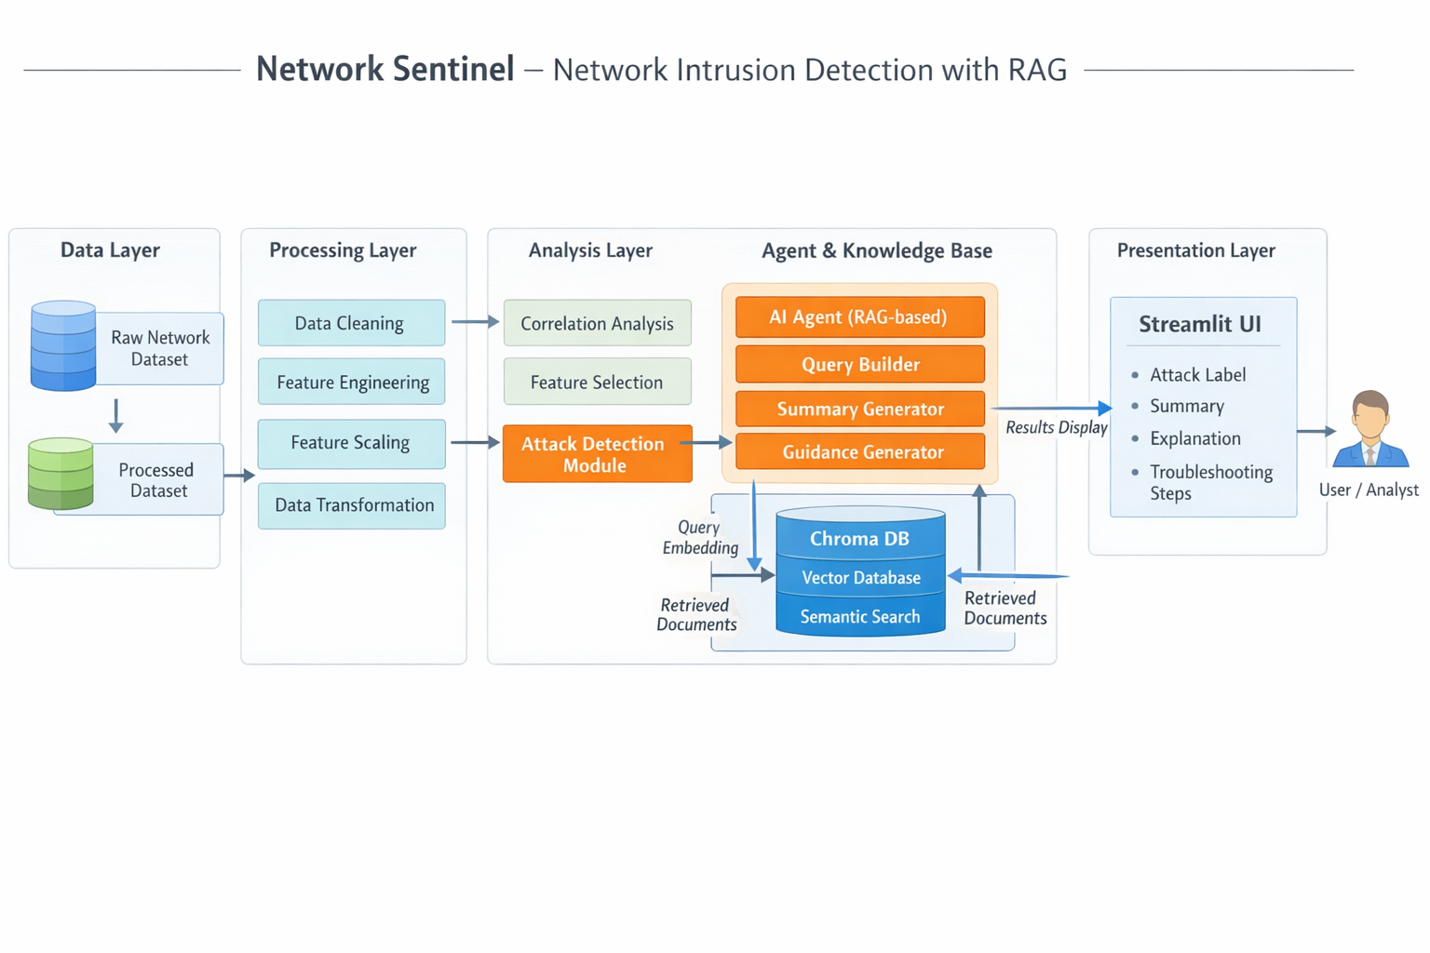
System Architecture
ML detects attack
RAG generates explanation using Chroma DB

Slide 4
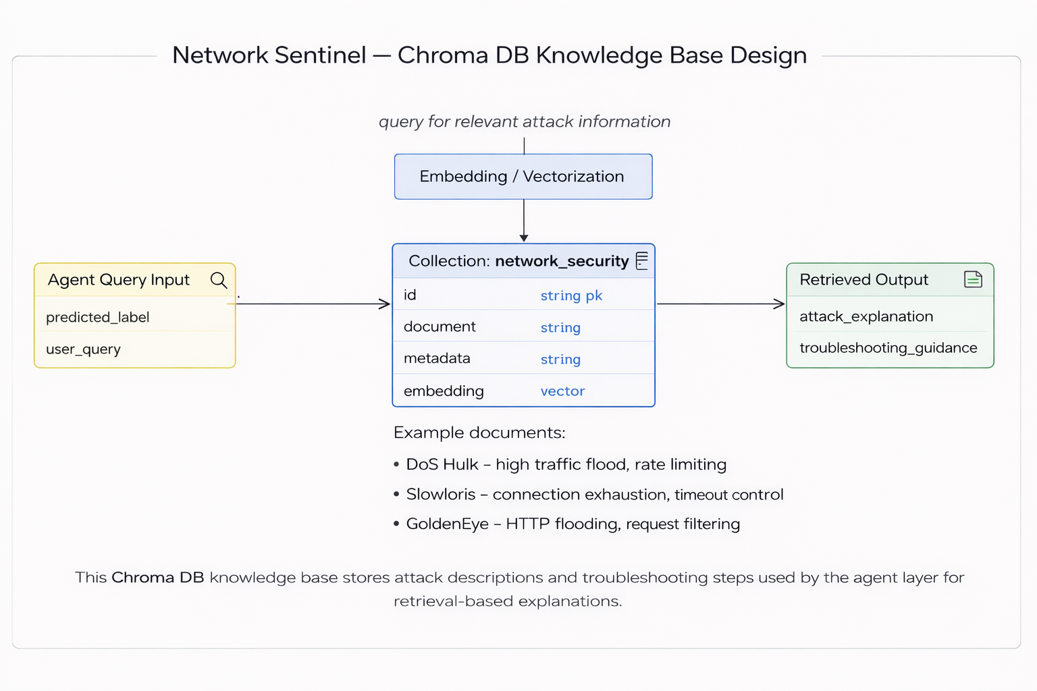
Intelligence Layer - Chroma DB Knowledge Base
Purpose
Stores cybersecurity knowledge (attack descriptions, mitigation)
Technology
Chroma DB (Vector Database)
Uses embeddings for semantic search
Input
Predicted attack label
User query
Output
Attack explanation
Troubleshooting guidance

Slide 5
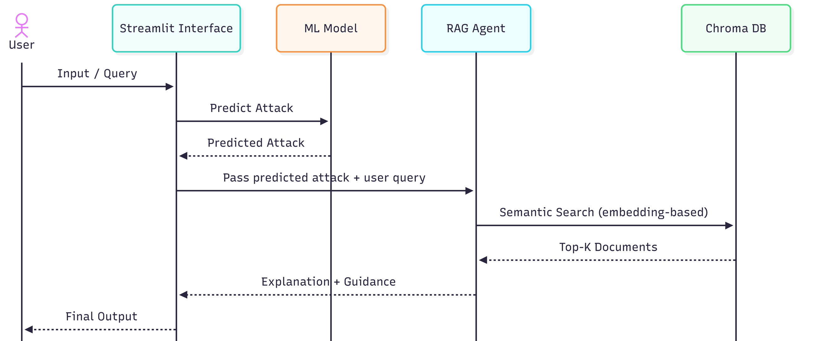
System Sequence Diagram – Network Sentinel (RAG-based Intrusion Detection)
Illustrates interaction between UI, ML model, RAG agent, and vector database for attack detection and explanation

Slide 6
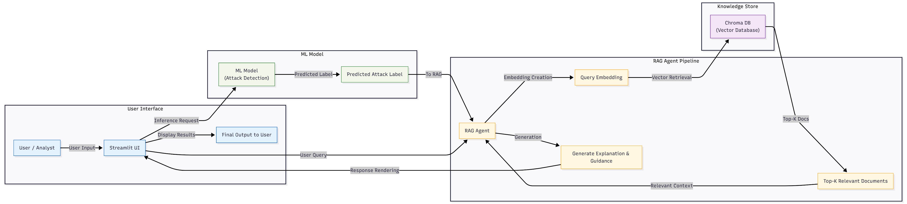
System Workflow
Key Components:
ML Model - Attack Detection
RAG Agent - Contextual reasoning
Chroma DB - Knowledge storage
Streamlit - User interface

